Slide 1
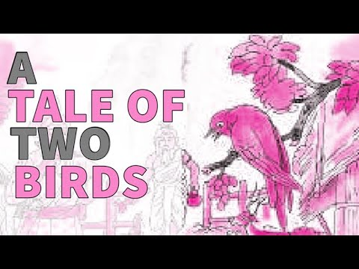

Slide 2
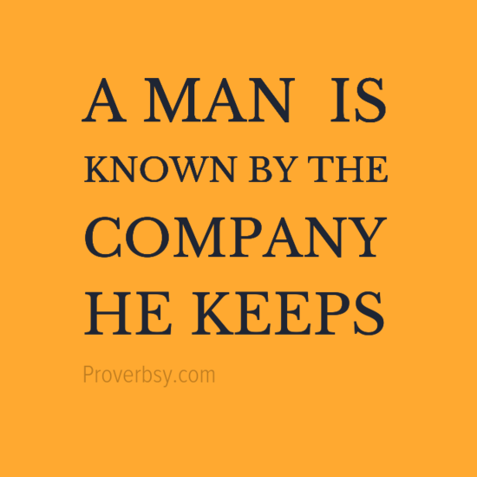

Slide 3
Introduction
‘A Tale Of Two Birds’ is a story of two birds and how they react to different situations in different ways even though they were born to the same mother. In fact, this story speaks and depicts the importance of the company one keeps. How one’s company can impact one’s behaviour and build a character.

Slide 4
Theme
We can see that even though both the birds had same mother still the way they react to similar situations is very different. Thus ,we can say that it doesn't affect where you are born but how you are bought up and the kind of people you are surrounded affects and develops your personality.

Slide 5
Summary
Once there lived a mother bird in a forest. Her two new-born babies also lived with her. Their nest was in a tall tree.
One day, there was thunder, lightning and rain. The stormy wind blew down the tall tree. Unluckily, the mother bird was killed. The strong wind blew away the little birds. One of them came down near a cave. A gang of robbers lived there. The other bird came down a little distance away. A rishi’s ashram was near that place. Thus the two birds were separated.

Slide 6
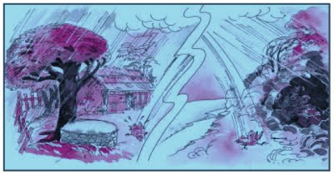

Slide 7
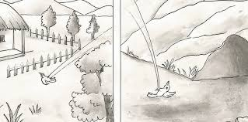

Slide 8
Summary Contd..
The first bird made his home on a tree near the cave of the robber. The second bird made his nest on a tree near the rishi’s ashram. After some time, the baby birds became big. One day, the king came there. He was following a deer. He was very tired. He got off his horse. There was a tree near a cave. The king sat under it to take rest. Just then, the king heard a big brown bird’s voice. It was inviting some robbers to come and snatch the king’s jewels and horse. The king got afraid. He got on his horse and rode away.

Slide 9
Summary Contd..
Soon, the king reached the rishi’s ashram. He sat down in the shade of a tree there. He heard a big brown bird asking the king to take rest inside the ashram. The king was amazed. He said, “This one looks like the other bird outside the cave.” The bird told the king that his brother had made friends with robbers. He talked like robbers.

Slide 10
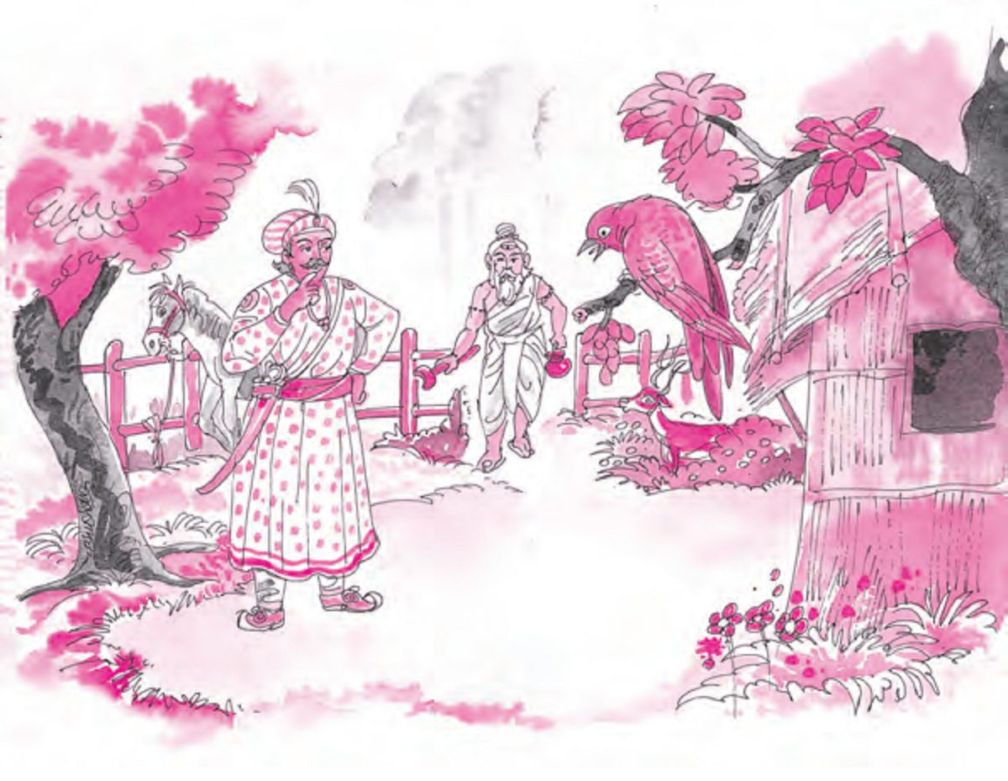

Slide 11
Summary Contd..
The rishi returned soon after. He invited the king to share his food. The king told the rishi about the different behaviour of the two birds. The rishi told him that it was the result of their company.

Slide 12
Moral
We should make friends with the people who are of good nature. If we take the company of bad people we will also become bad.
‘A Man is Known by the company he keeps’

Slide 13
Words Meaning
Robbers : Person who commits robbery, a thief, a burglar
Fortunately : luckily, happily, by good luck
blew down : to make fall
Hunt : to chase and try to catch and kill, to pursue
Alike : similar, identical
Welcome : to greet
Imitates : copies

Slide 14

Hunt

Slide 15
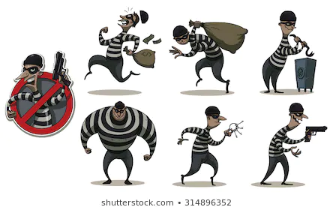
Robbers

Slide 16

Blew Down

Slide 17
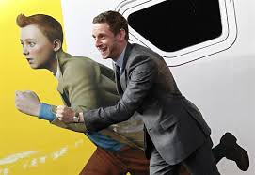
Imitate

Slide 18
Q&A
What is the moral of the story a tale of two birds?
What lesson do we learn from a tale of two birds?
What is the theme of the story the birds?
How did the two birds live before being separated?

